Slide 2
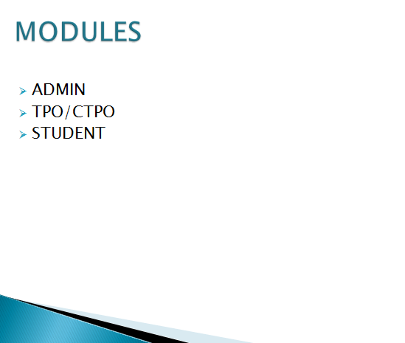

Slide 3

Home Page

Slide 4
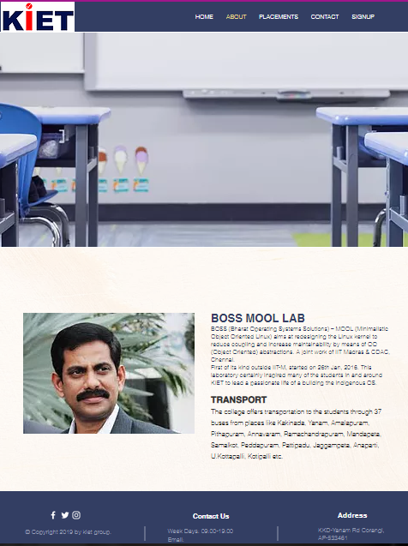
About page

Slide 5

Placements Page

Slide 6
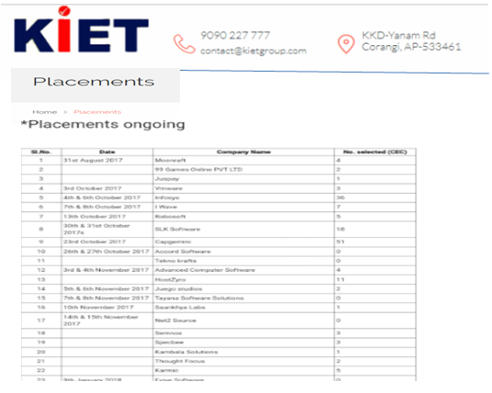

Slide 7
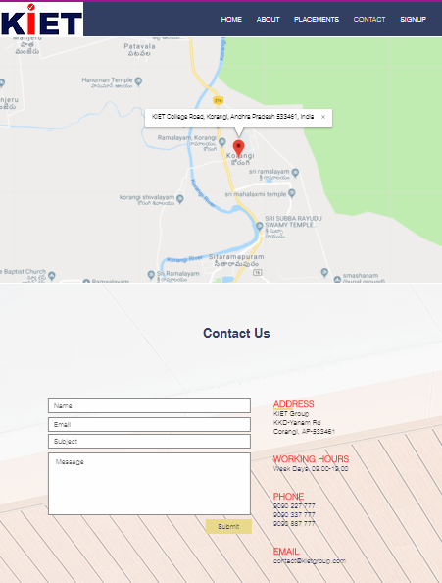
Contact Page

Slide 8
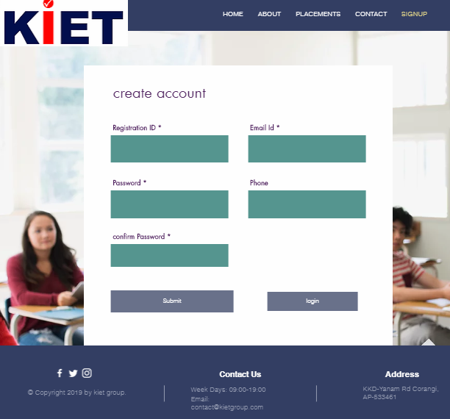
Signup Page

Slide 9
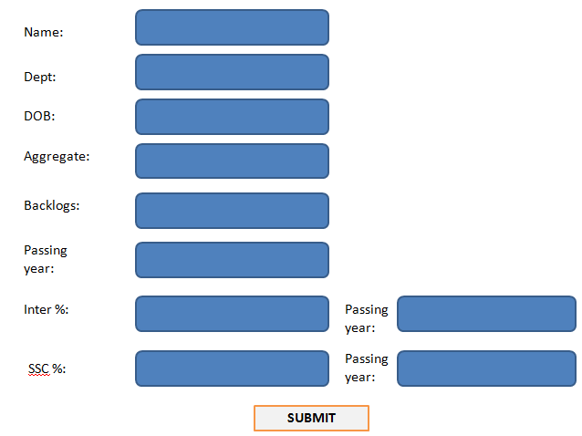
Student Registration Form

Slide 10
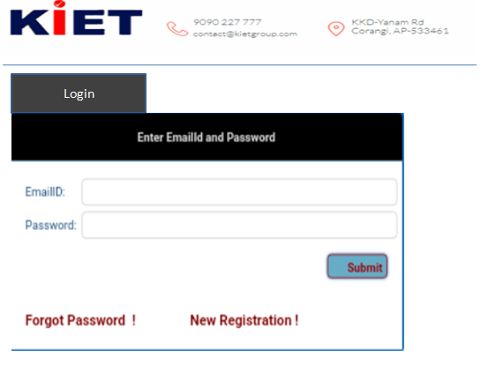
Login Page

Slide 11
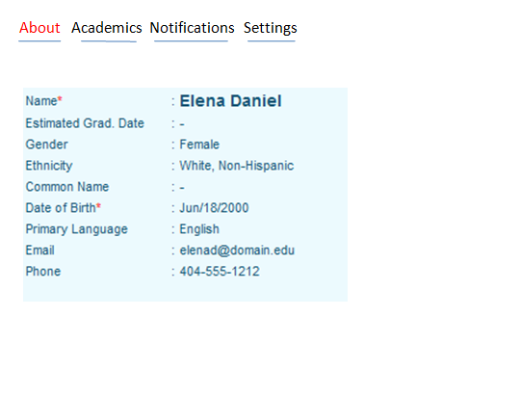
Student Dashboard

Slide 12
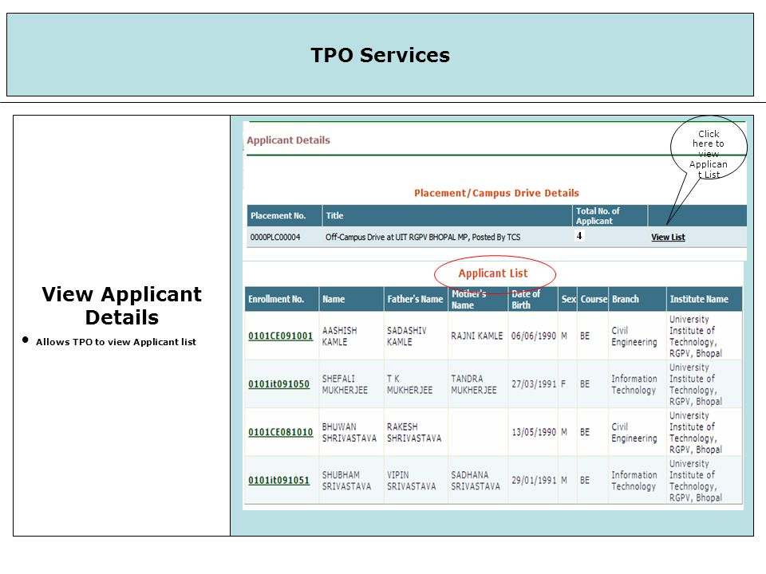
TPO Dashboard

Slide 13
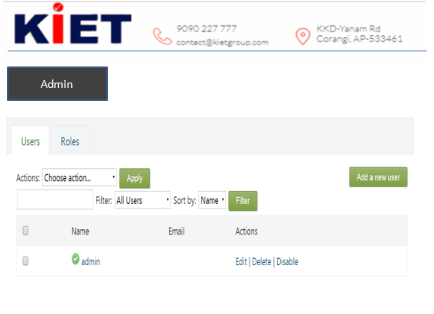
Admin Dashboard

Slide 14
DATABASE SCHEMA
Registration Table
S.NO | Attributes | Data Type | NULL
1 | Id(Primary) | Varchar | No
2 | Name | String | No
3 | Branch | String | No
4 | Email id | Varchar | No
5 | DOB | Date | No
6 | Contact No | Numeric | Yes
7 | Qualification Level | Varchar | No
8 | Education specification | Varchar | No
9 | Aggregate | Float | No
10 | Backlogs | Numeric | Yes
11 | Passing year | Date | No
12 | Password | Varchar | No
13 | Confirm password | Varchar | No

Slide 15
Drive Table
S.NO | Attributes | Data Type | NULL
1 | Company name | string | No
2 | profile description | Text | No
3 | Eligibility criteria | Varchar | No
4 | Year of passing | Date | No
5 | Package | Varchar | No
6 | Date of Drive | Date | No
7 | Job location | String | No
8 | Official email | Varchar | No
9 | On/off campus | String | No
10 | No of rounds | Numeric | No
11 | Type of offer | String | No
12 | Registration link | Varchar | No
13 | Registration close | Date | No
14 | Drive Incharge | String | No
15 | Min no of students required | Numeric | No

Slide 16
Placement Table
S.NO | Attributes | Data Type | NULL
1 | Company Name | String | No
2 | No. of Students Attended | Numeric | No
3 | No. of Students Placed | Numeric | Yes
4 | Average package | Numeric | No
DEMO WEBSITE LINK:
https://lakshmiposimudunur.wixsite.com/placementportal

